Slide 1
CSS
MCNDHS
Ms. Eng

Slide 2
AIM: HOW DO WE FIND COMPLEMENTING COLORS?
Do now:
Write down three hexadecimal colors.
Daily Grade:
On-time/attendance/not leaving the classroom: 25%
Cellphones: 25%
Notes:25%
Classwork/Homework: 25%

Slide 3

HOW TO CHOOSE BEAUTIFUL COLORS

Slide 4

ANALOG COLORS

Slide 5

COMPLEMENTARY COLORS

Slide 6

SPLIT COMPLEMENTARY

Slide 7

TRIAD COLORS

Slide 8
STEP 1: CHOOSE A COLOR
Choose any color on the color spectrum.
Write down the hex value

Slide 9

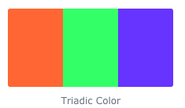
EXAMPLE 1:

Slide 10
ACTIVITY
pick TWO colors.
Find the triadic complements for the two colors you chose.

